Slide 1
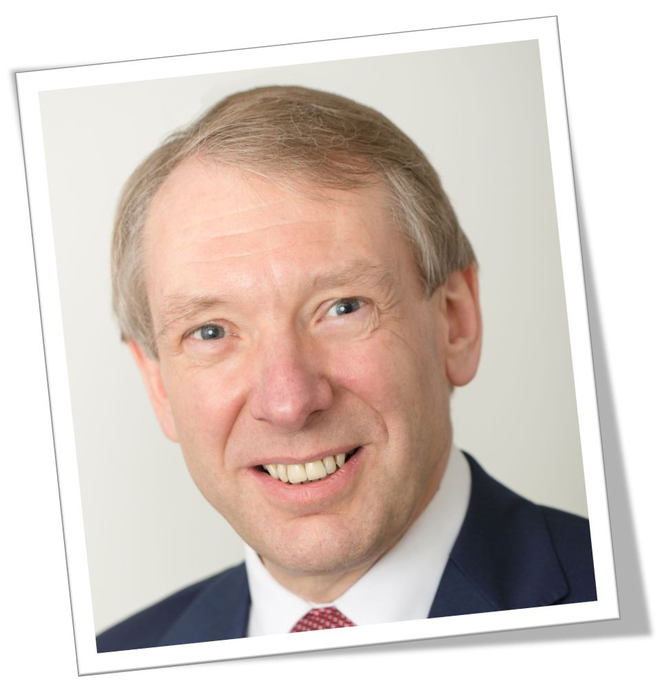
Coach
Facilitator
Trainer
Notes:
Hello. My name’s Robin Hills. I’m an emotional Intelligence coach, facilitator and trainer.
Others are presenting on coaching and facilitation, so I will focus this presentation on the training part of my business.

Slide 2

Notes:
My company is Ei4Change – Emotional Intelligence 4 Change – specialising in emotional intelligence and change at the personal level the team level and the organisational level
Ei4Change has been trading for over 10 years but has been adapting o constant change in the marketplace with the introduction of new technologies, social media and shifts in consumer demands.
We are at the beginning of a new major shift which takes us into a completely new paradigm. This was unthought of at the beginning of the month and will continue to have ramifications over the coming years.

Slide 3

Notes:
Here is a highlight from my degree certificate from 40 years ago! You will notice that the –ology that I studied was Biology, not psychology.
I have developed a keen interest in human behaviour and it’s expression in business over my career and I am pleased that my work in this field has been recognised by the Association for Business Psychology.

Slide 4

Notes:
Over the last few years, I have conducted some qualitative research into resilience in the workplace. This has resulted in a series of publications and the development of a commercially available coaching toolbox – Images of Resilience.
This toolbox is even more relevant today than when it was published about 10 years ago. (By today, I mean the current situation around Coronavirus!)

Slide 5

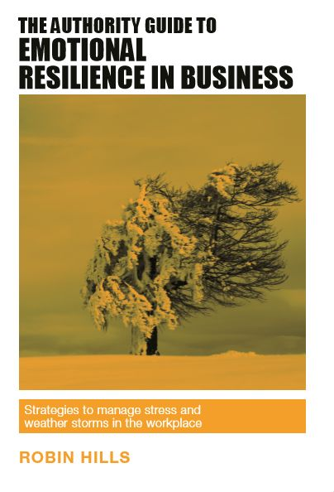
Notes:
I have two books published in The Authority Guide Series.
The Authority Guide to Emotional Resilience in Business
The Authority Guide to Behaviour in Business
Whilst both books have sold well, the have proved to be even more popular as online courses.
Since we have been in lockdown, I have made course The Authority Guide to Emotional Resilience in Business free. You can access it here
https://courses.ei4change.info/courses/the-authority-guide-to-emotional-resilience/

Slide 6

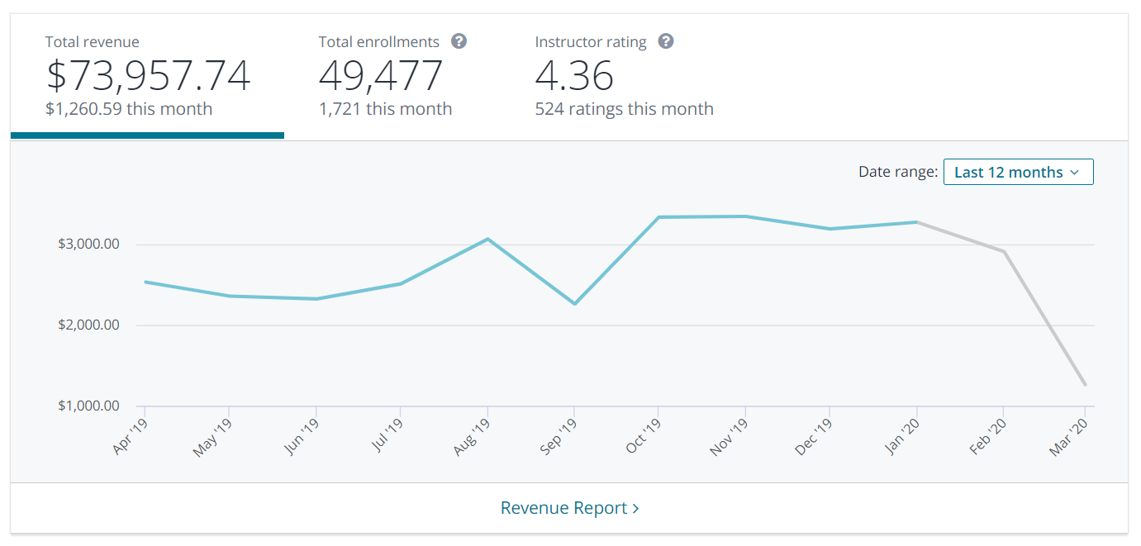
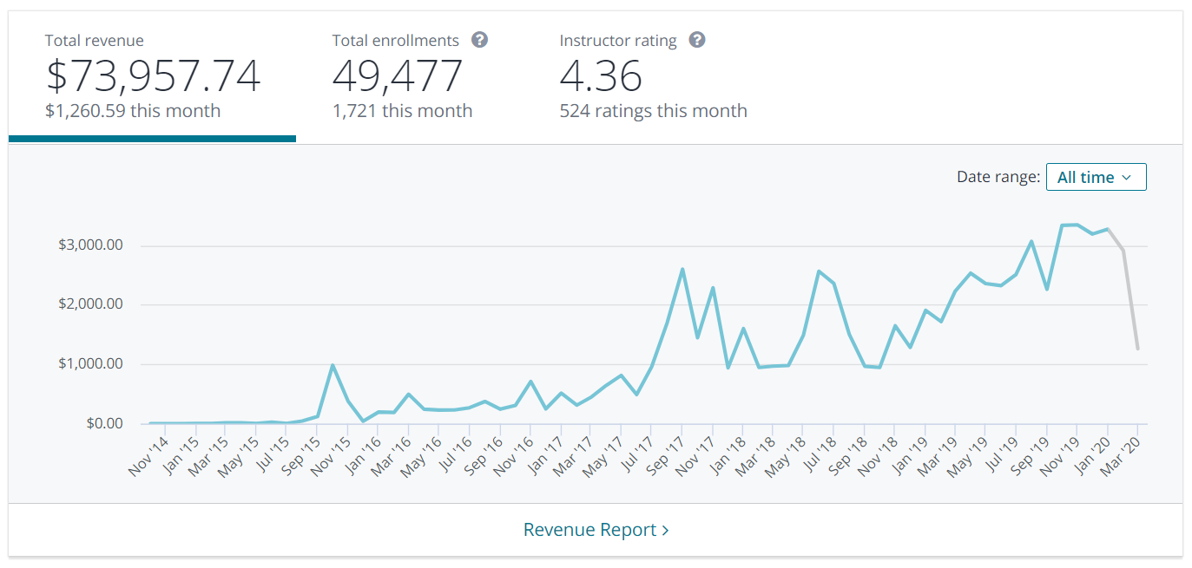
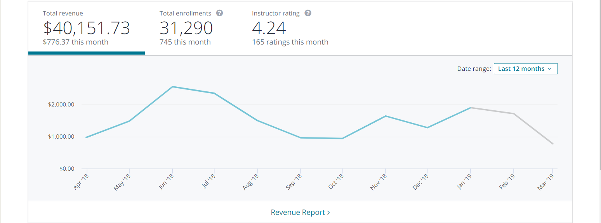
Notes:
One of the major platforms that features my courses is Udemy.
Here is a screen shot of my sales on Udemy since my first course was published at the end of 2014.
Sales this month have been phenomenal with many people learning new skills and refreshing old ones whilst they are at home.

Slide 7
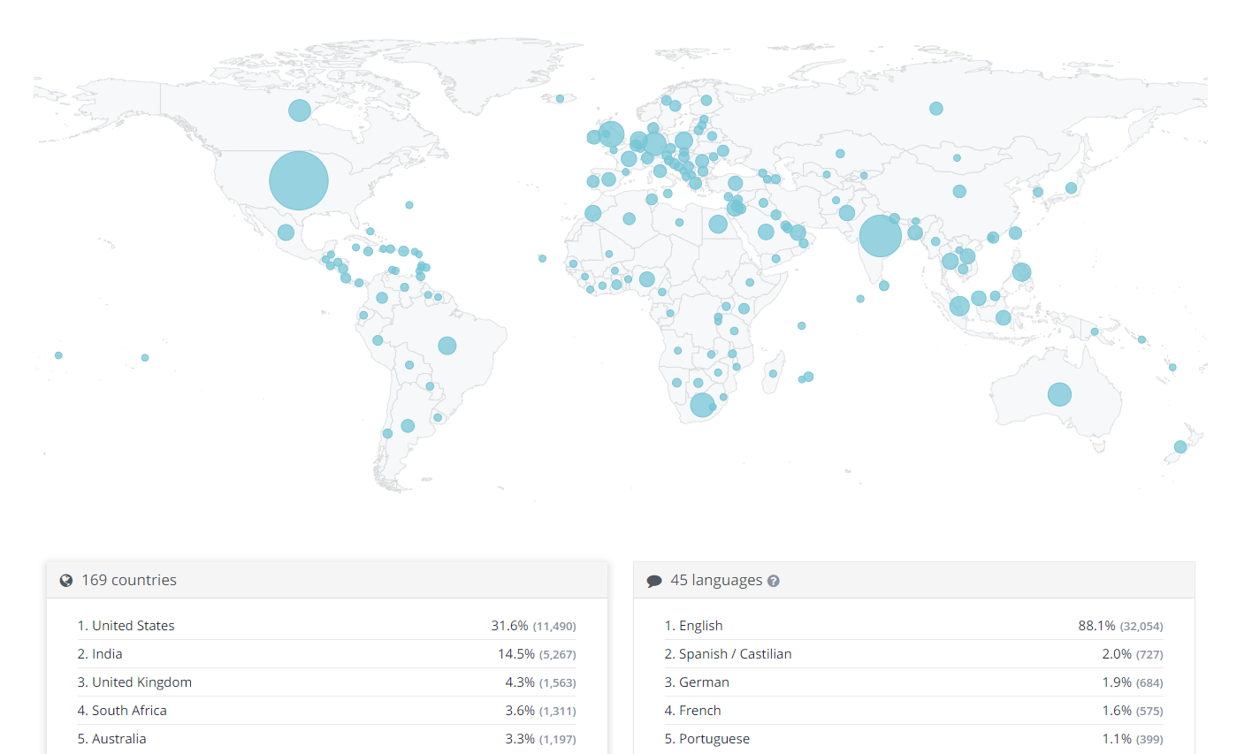
Notes:
Here is the distribution of learners on a world map. You can see that my courses have sold in over 165 countries.

Slide 8
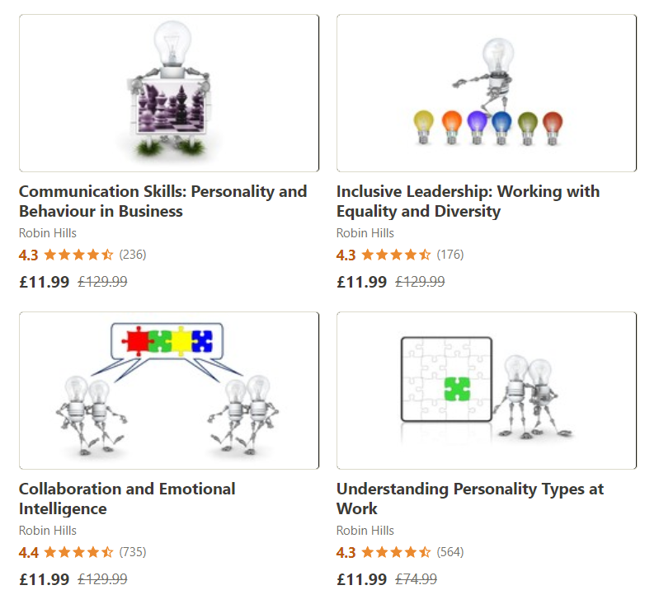
Notes:
Here is a small selection of some of my courses on the Udemy platform.

Slide 9



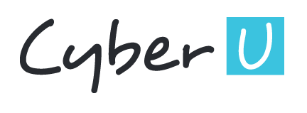


Notes:
Udemy is not the only learning platform where my courses are featured.
They are also available on
Skillshare
SkillSuccess
Learn@Forbes
CyberU
CPDFormula
Simpliv
And there are many more…

Slide 10
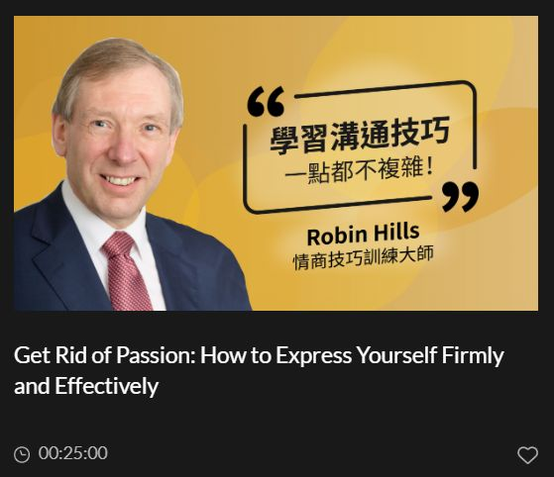
Notes:
My courses have been translated into traditional Chinese and Mandarin on a newly launched platform focussing on the Chinese market.

Slide 11
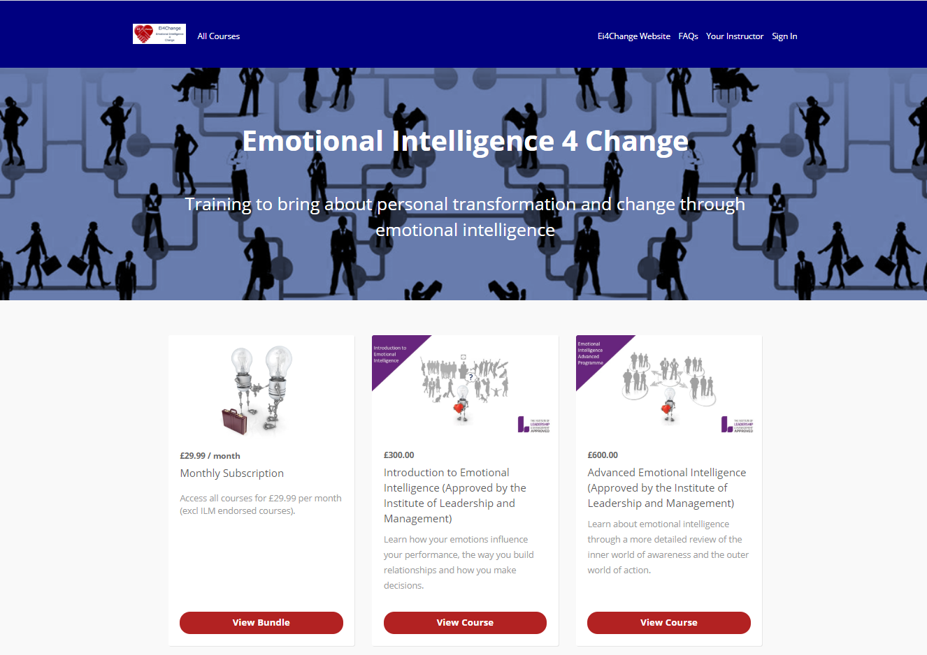
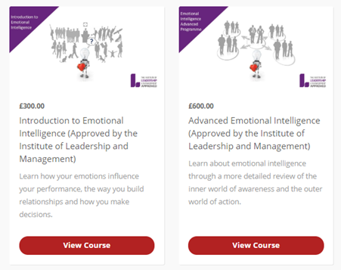
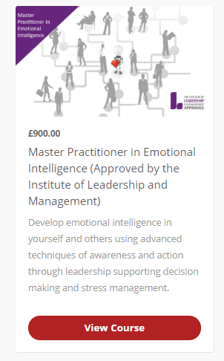
Notes:
Here are my courses available through the Ei4Change website.
These three courses are uniquely available on this site. They are accredited by The Institute of Leadership and Management offering
A certificate from The Institute of Leadership and Management and Ei4Change
A year’s membership of The Institute of Leadership and Management
The opportunity to use the letters AInstLM or MInstLM after your name
The plans for the coming months – starting in April 2020 – is to use a specialised digital marketing company to further promote these courses. These plans have not changed over the last couple of weeks!

Slide 12



@ei4change
Ei4Change
Ei4Change
Ei4Change
www.ei4change.com
courses.ei4change.info
Notes:
In conclusion, a career in Psychology is down to you to make and grow it as the opportunity presents.
Back 40 years ago, personal computers and the internet were not around. My degree and my skill set have helped me to evolve and adapt to changing circumstances. Over the last few years, I have learnt videography skills, film editing, sound engineering, etc. to complement my work.
It is your attitude, your optimism, your adaptability, your creativity, your resilience and your emotional intelligence that will get you a career to be proud of. Nothing else!
Please feel free to contact me and connect via the links above. You can also contact me at robin@ei4change.com
I wish you every success for the future.

